Slide 1
Class 17 - File Systems
Osama Hosam Eldeen
Taiba University

Slide 2
Why do we need a file system?
Must store large amounts of data
Data must survive the termination of the process that created it
  Called “persistence”
Multiple processes must be able to access the information concurrently

Slide 3
What is a file?
Files can be structured or unstructured
  Unstructured: just a sequence of bytes
  Structured: a sequence or tree of typed records
In Unix-based operating systems a file is an unstructured sequence of bytes

Slide 4
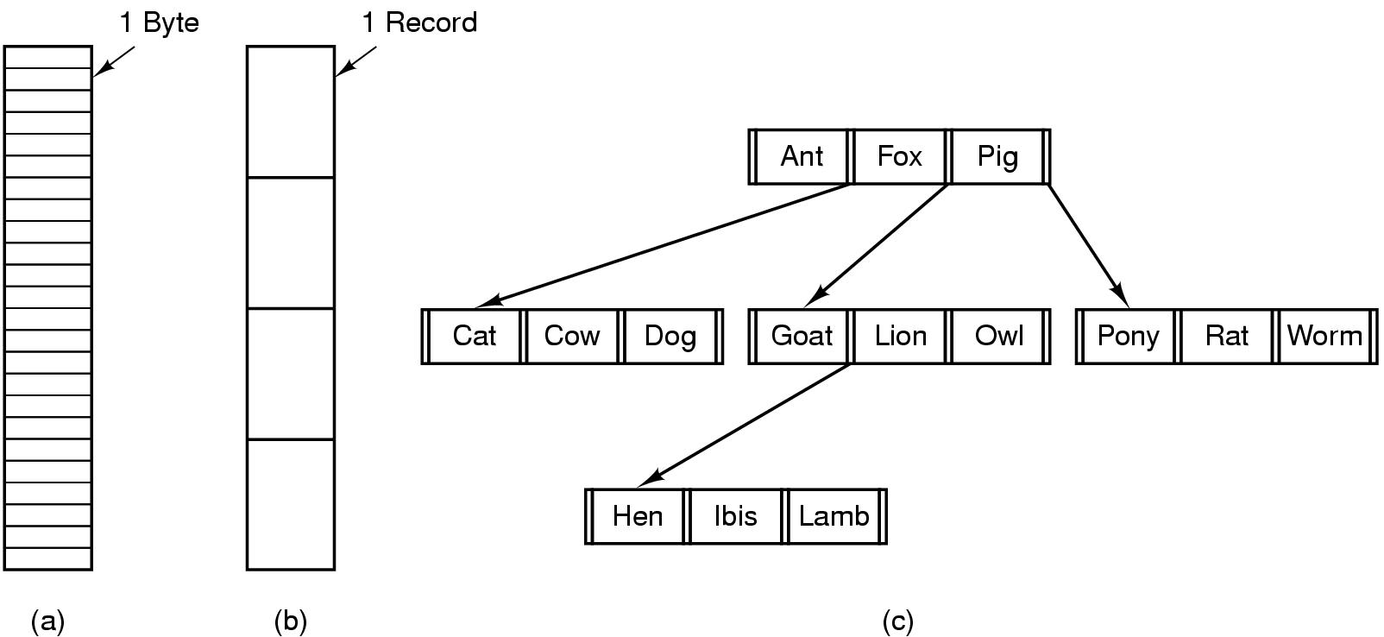
File Structure
asd
Sequence
of bytes
Sequence
of records
Tree
of records

Slide 5
File extensions
Even though files are just a sequence of bytes, programs can impose structure on them, by convention
  Files with a certain standard structure imposed can be identified using an extension to their name
  Application programs may look for specific file extensions to indicate the file’s type
  But as far as the operating system is concerned its just a sequence of bytes

Slide 6
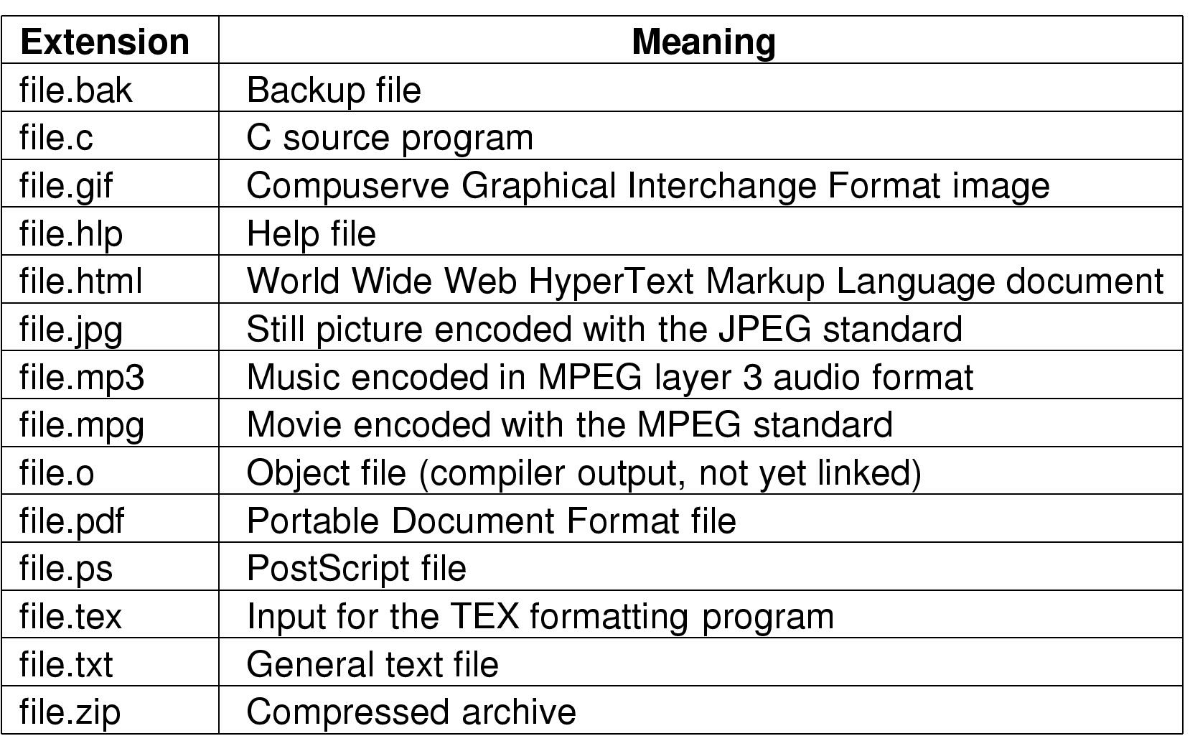
Typical file extensions

Slide 7
Which file types does the OS understand?
Executable files
  The OS must understand the format of executable files in order to execute programs
    Create process (fork)
    Put program and data in process address space (exec)

Slide 8
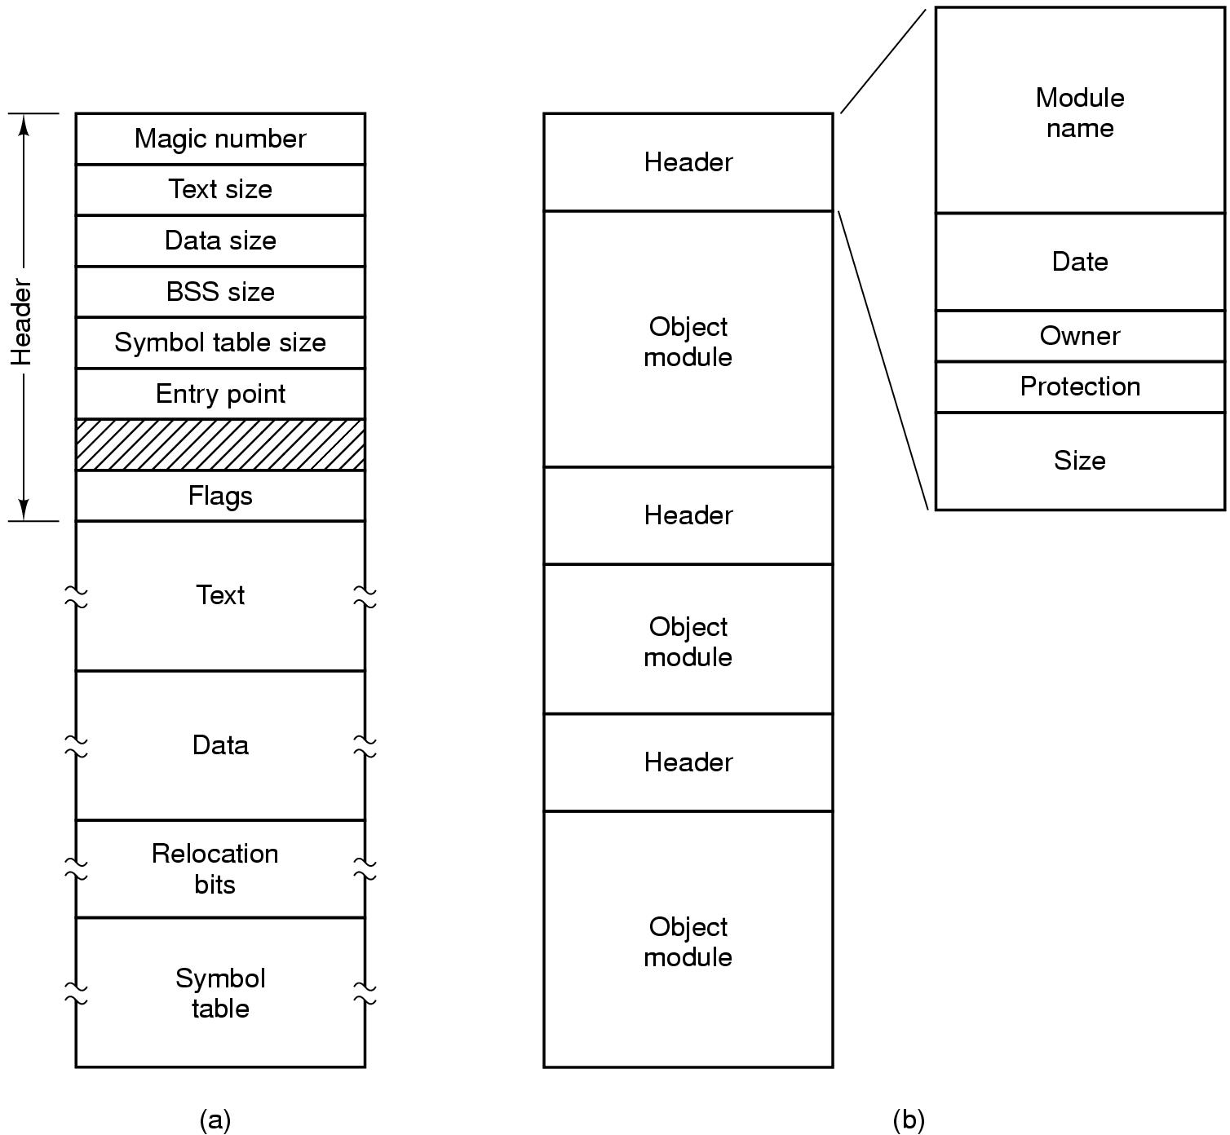
Executable file formats
An executable file
An archive

Slide 9
File attributes
Various meta-data needs to be associated with files
  Owner
  Creation time
  Access permissions / protection
  Size etc
This meta-data is called the file attributes
  Maintained in file system data structures for each file

Slide 10
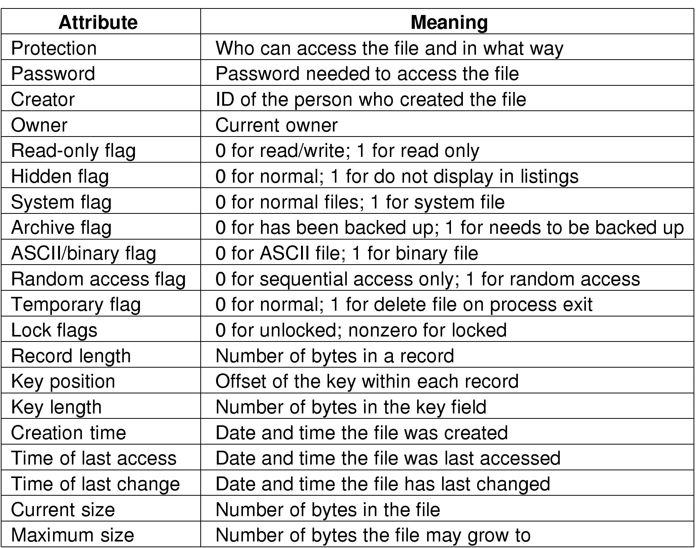
Example file attributes
Examples

Slide 11
File access
Sequential Access
  read all bytes/records from the beginning
  cannot jump around (but could rewind or back up) convenient when medium was magnetic tape
Random Access
  can read bytes (or records) in any order
  essential for database systems
  option 1:
    move position, then read
  option 2:
    perform read, then update current position

Slide 12
Some file-related system calls
Create a file
Delete a file
Open
Close
Read (n bytes from current position)
Write (n bytes to current position)
Append (n bytes to end of file)
Seek (move to new position)
Get attributes
Set/modify attributes
Rename file

Slide 13
File-related system calls
fd = open (name, mode)
byte_count = read (fd, buffer, buffer_size)
byte_count = write (fd, buffer, num_bytes)
close (fd)

Slide 14
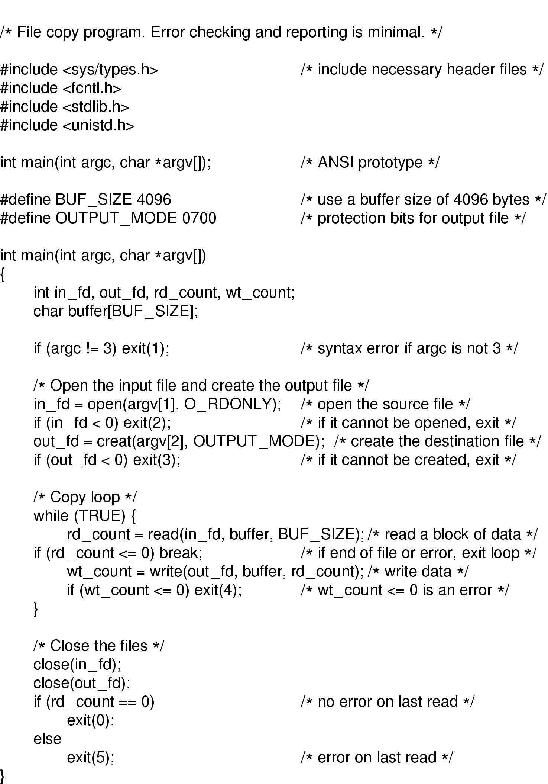
A “C” Program to Copy a File
(continued)

Slide 15
A “C” Program to Copy a File

Slide 16
File storage on disk
Sector 0: “Master Boot Record” (MBR)
  Contains the partition map
Rest of disk divided into “partitions”
  Partition: sequence of consecutive sectors.
Each partition can hold its own file system
  Unix file system
  Window file system
  Apple file system
Every partition starts with a “boot block”
  Contains a small program
  This “boot program” reads in an OS from the file system in that partition
OS Startup
  Bios reads MBR , then reads & execs a boot block

Slide 17
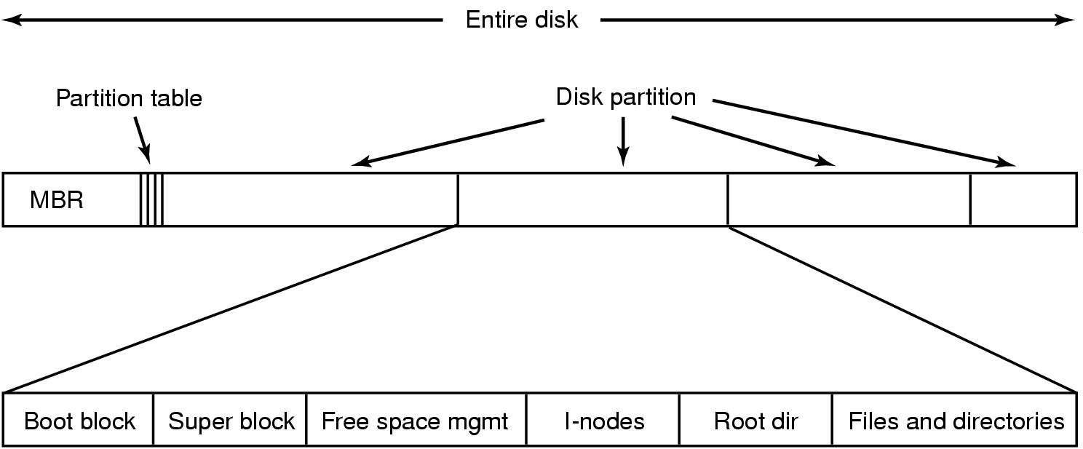
An example disk

Slide 18
An example disk
Unix File System

Slide 19
File bytes vs disk sectors
Files are sequences of bytes
  Granularity of file I/O is bytes
Disks are arrays of sectors (512 bytes)
  Granularity of disk I/O is sectors
  Files data must be stored in sectors
File systems define a block size
  block size = 2^{n} * sector size
  Contiguous sectors are allocated to a block
File systems view the disk as an array of blocks
  Must allocate blocks to file
  Must manage free space on disk

Slide 20

Contiguous allocation
Idea:
  All blocks in a file are contiguous on the disk
After deleting D and F...

Slide 21
Contiguous allocation
Idea:
  All blocks in a file are contiguous on the disk.
After deleting D and F...

Slide 22
Contiguous allocation
Advantages:
  Simple to implement (Need only starting sector & length of file)
  Performance is good (for sequential reading)

Slide 23
Contiguous allocation
Advantages:
  Simple to implement (Need only starting sector & length of file)
  Performance is good (for sequential reading)
Disadvantages:
  After deletions, disk becomes fragmented
  Will need periodic compaction (time-consuming)
  Will need to manage free lists
  If new file put at end of disk...
    No problem
  If new file is put into a “hole”...
    Must know a file’s maximum possible size ... at the time it is created!

Slide 24
Contiguous allocation
Good for CD-ROMs
  All file sizes are known in advance
  Files are never deleted

Slide 25

Linked list allocation
Each file is a sequence of blocks
First word in each block contains number of next block

Slide 26
Linked list allocation
Each file is a sequence of blocks
First word in each block contains number of next block
Random access into the file is slow!

Slide 27
File allocation table (FAT)
Keep a table in memory
One entry per block on the disk
Each entry contains the address of the “next” block
  End of file marker (-1)
A special value (-2) indicates the block is free

Slide 28
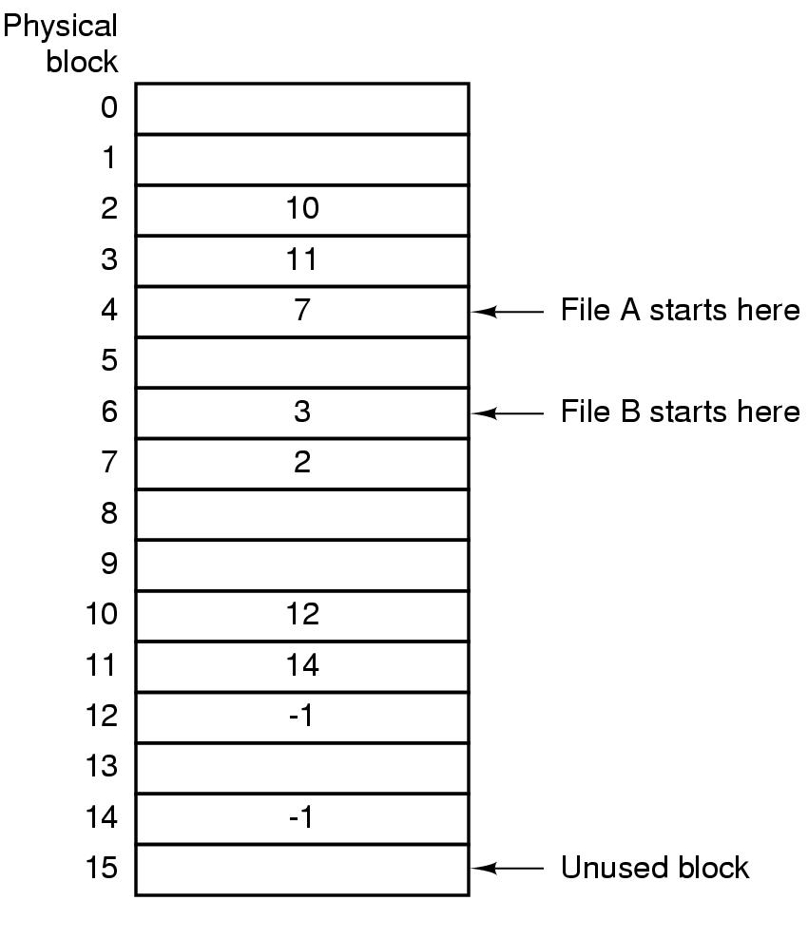
File allocation table (FAT)

Slide 29
File allocation table (FAT)

Slide 30
File allocation table (FAT)

Slide 31
File allocation table (FAT)

Slide 32
File allocation table (FAT)

Slide 33
File allocation table (FAT)

Slide 34
File allocation table (FAT)

Slide 35
File allocation table (FAT)

Slide 36
File allocation table (FAT)
Random access...
  Search the linked list (but all in memory)
Directory entry needs only one number
  Starting block number

Slide 37
File allocation table (FAT)
Random access...
  Search the linked list (but all in memory)
Directory Entry needs only one number
  Starting block number
Disadvantage:
  Entire table must be in memory all at once!
  A problem for large file systems

Slide 38
File allocation table (FAT)
Random access...
  Search the linked list (but all in memory)
Directory Entry needs only one number
  Starting block number
Disadvantage:
  Entire table must be in memory all at once!
  Example:
    20 GB = disk size
    1 KB = block size
    4 bytes = FAT entry size
    80 MB of memory used to store the FAT

Slide 39
I-nodes
Each I-node (“index-node”) is a structure / record
Contains info about the file
  Attributes
  Location of the blocks containing the file
Blocks
on disk
Other
attributes
I-node

Slide 40
I-nodes
Each I-Node (“index-node”) is a structure / record
Contains info about the file
  Attributes
  Location of the blocks containing the file
Enough space
for 10 pointers
Blocks
on disk
Other
attributes
I-node

Slide 41
I-nodes
Each I-Node (“index-node”) is a structure / record
Contains info about the file
  Attributes
  Location of the blocks containing the file
Enough space
for 10 pointers
Blocks
on disk
Other
attributes
I-node

Slide 42
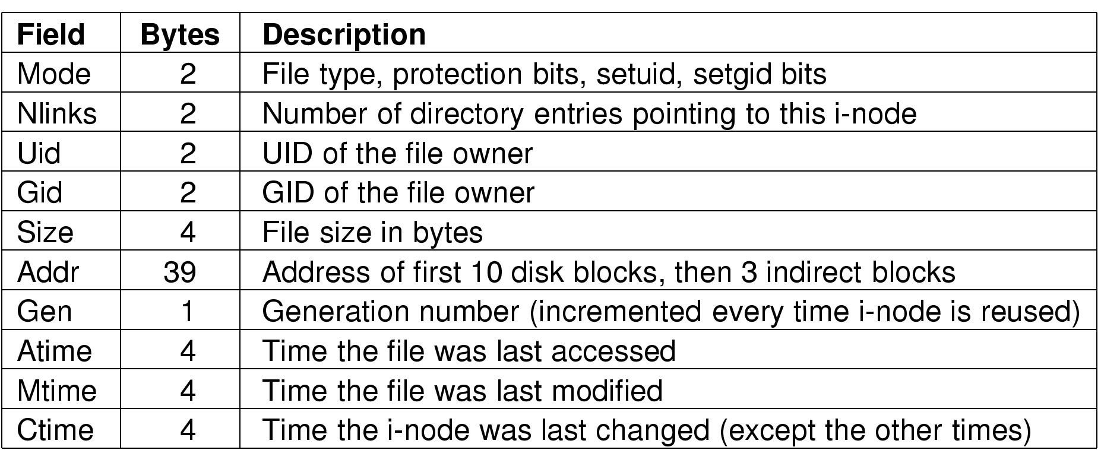
The UNIX I-node entries
Structure of an I-Node

Slide 43
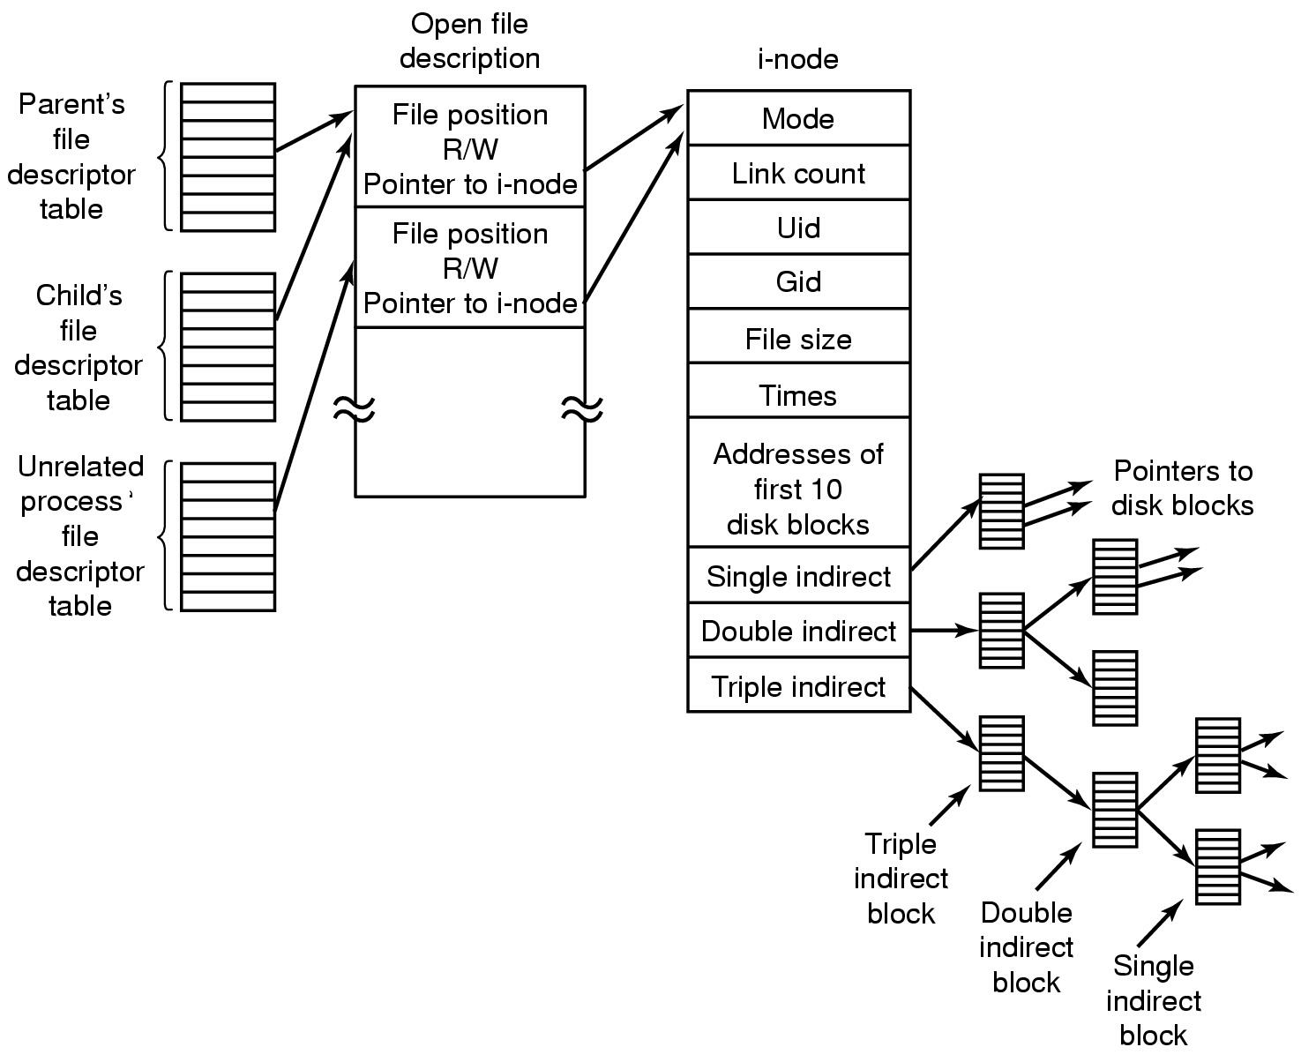
The UNIX I-node

Slide 44
The UNIX File System

Slide 45
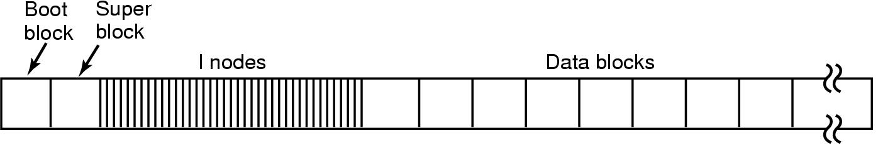
The UNIX file system
The layout of the disk (for early Unix systems):

Slide 46
Naming files
How do we find a file given its name?
How can we ensure that file names are unique?

Slide 47
Single level directories
“Folder”
Single-Level Directory Systems
  Early OSs
Problem:
  Sharing amongst users
Appropriate for small, embedded systems
Root Directory
a
b
c
d

Slide 48
Two-level directory systems
Letters indicate who owns the file / directory.
Each user has a directory.
  /peter/g
Root Directory
harry
peter
todd
micah
a
b
c
d
e
c
g
a
d
b
e

Slide 49
Hierarchical directory systems
A tree of directories
  Interior nodes: Directories
  Leaves: Files
/
A
B
C
i
D
j
E
F
k
l
m
n
G
H
o
p
q

Slide 50
Hierarchical directory systems
Root Directory
A tree of directories
  Interior nodes: Directories
  Leaves: Files
/
A
B
C
User’s Directories
i
D
j
E
F
k
l
m
n
G
H
Sub-directories
o
p
q

Slide 51
Path names
MULTICS
  >usr>jon>mailbox
Windows
  \usr\jon\mailbox
Unix
  /usr/jon/mailbox

Slide 52
Path names
MULTICS
  >usr>jon>mailbox
Windows
  \usr\jon\mailbox
Unix
  /usr/jon/mailbox
Absolute Path Name
  /usr/jon/mailbox
Relative Path Name
  “working directory” (or “current directory”)
  mailbox
Each process has its own
working directory

Slide 53
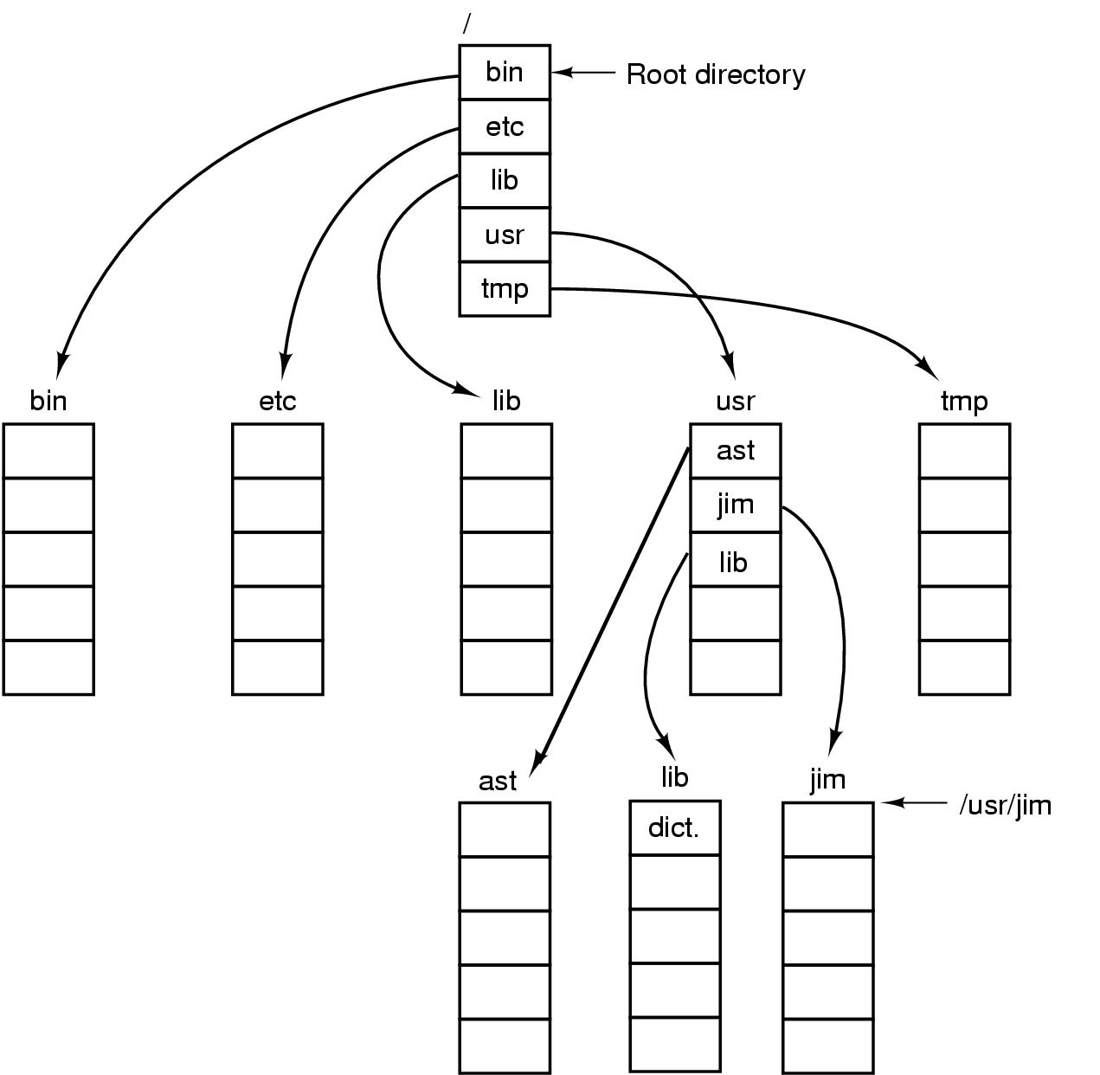
A Unix directory tree
. is the “current directory”
.. is the parent

Slide 54
Typical directory operations
Create a new directory
Delete a directory
Open a directory for reading
Close
Readdir - return next entry in the directory
  Returns the entry in a standard format, regardless of the internal representation
Rename a directory
Link
  Add this directory as a sub directory in another directory. (ie. Make a “hard link”.)
Unlink
  Remove a “hard link”

Slide 55
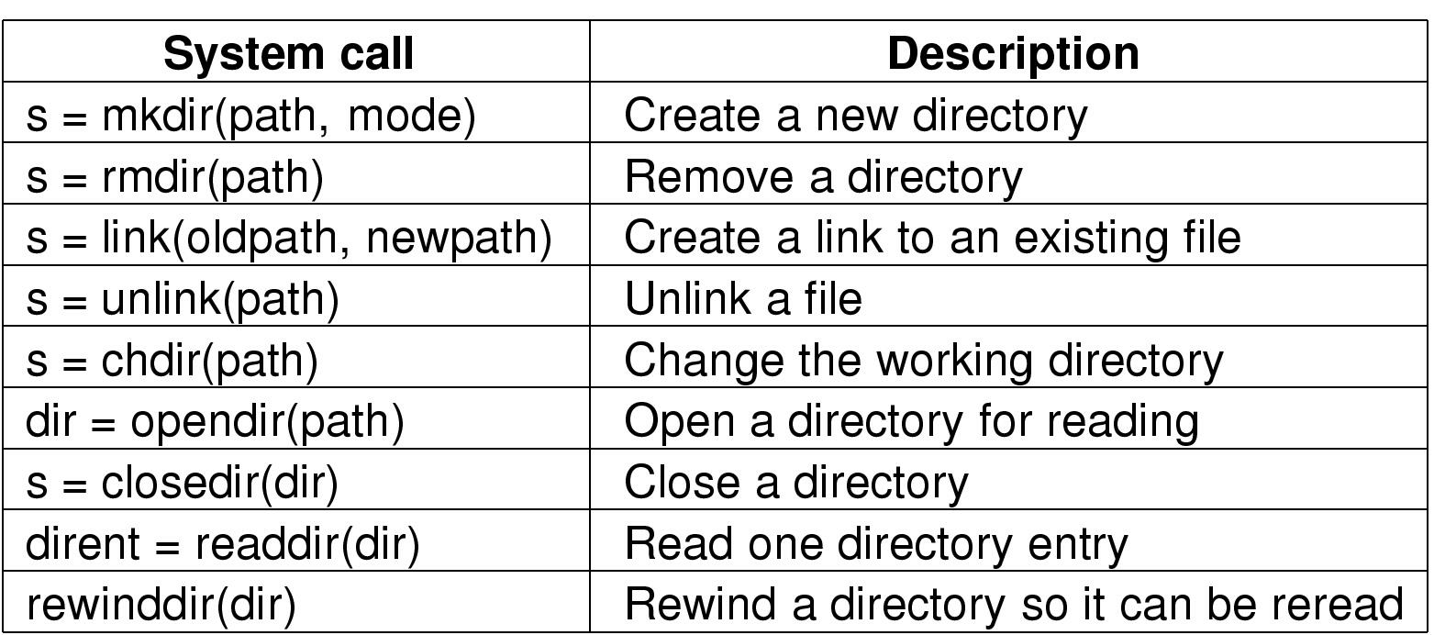
Unix directory-related syscalls
s = error code
dir = directory stream
dirent = directory entry

Slide 56
Implementing directories
List of files
  File name
  File Attributes
Simple Approach:
  Put all attributes in the directory

Slide 57
Implementing directories
List of files
  File name
  File Attributes
Simple Approach:
  Put all attributes in the directory
Unix Approach:
  Directory contains
    File name
    I-Node number
  I-Node contains
    File Attributes

Slide 58
Implementing directories
Simple Approach
“Kernel.h”
attributes
“Kernel.c”
attributes
“Main.c”
attributes
“Proj7.pdf”
attributes
“temp”
attributes
“os”
attributes
•
•
•
•
•
•

Slide 59
Implementing directories
i-node
Unix Approach
“Kernel.h”
i-node
“Kernel.c”
i-node
“Main.c”
“Proj7.pdf”
i-node
“temp”
i-node
“os”
•
•
•
•
•
•
i-node

Slide 60
Implementing filenames
Short, Fixed Length Names
  MS-DOS/Windows
    8 + 3 “FILE3.BAK”
    Each directory entry has 11 bytes for the name
  Unix (original)
    Max 14 chars

Slide 61
Implementing filenames
Short, Fixed Length Names
  MS-DOS/Windows
    8 + 3 “FILE3.BAK”
    Each directory entry has 11 bytes for the name
  Unix (original)
    Max 14 chars
Variable Length Names
  Unix (today)
    Max 255 chars
    Directory structure gets more complex

Slide 62
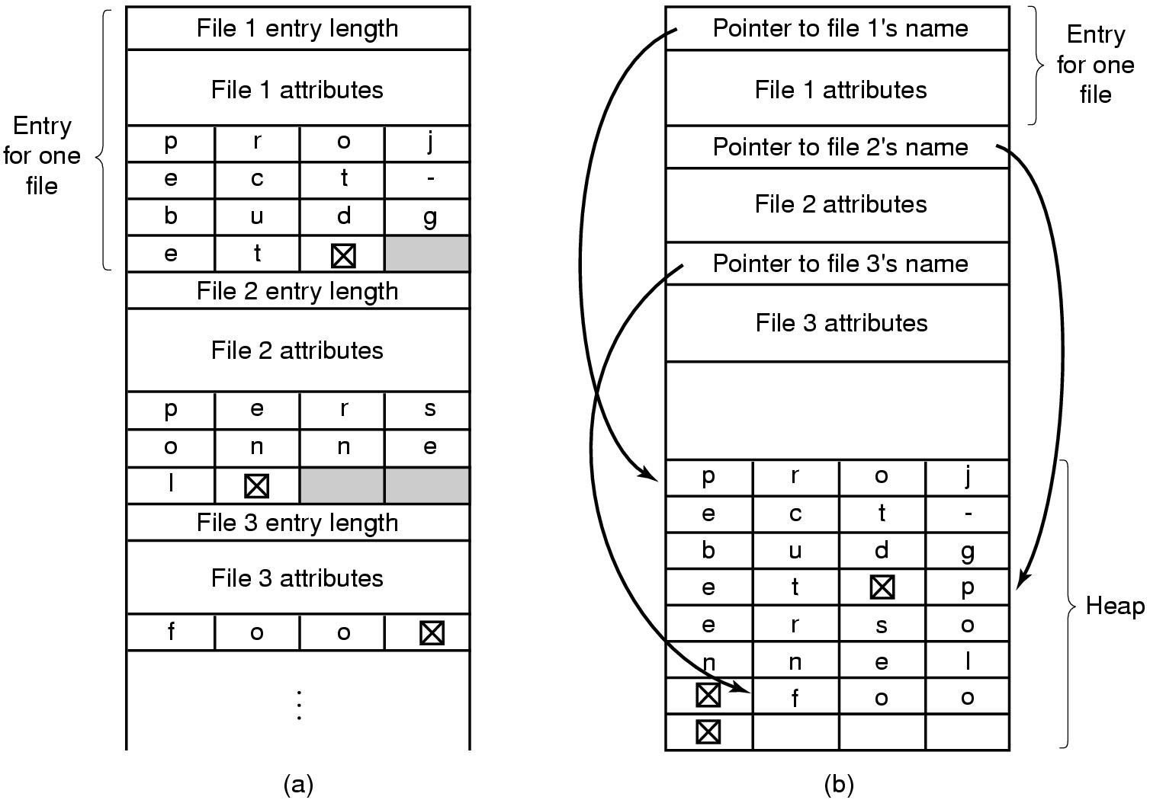
Variable-length filenames
Approach #1 Approach #2

Slide 63
Variable-length filenames
Approach #1 Approach #2

Slide 64
Sharing files
One file appears in several directories.
Tree → DAG
/
A
B
C
i
D
j
E
F
k
l
m
G
H
n
o
p
q

Slide 65
Sharing files
One file appears in several directories.
Tree → DAG (Directed Acyclic Graph)
/
A
B
C
i
D
j
E
F
k
l
m
G
H
n
o
p
q

Slide 66
Sharing files
One file appears in several directories.
Tree → DAG (Directed Acyclic Graph)
/
A
B
C
i
D
j
E
F
k
l
m
What if the file changes?
New disk blocks are used.
Better not store this info
in the directories!!!
G
H
n
o
p
q

Slide 67
Hard links and symbolic links
In Unix:
  Hard links
    Both directories point to the same i-node
  Symbolic links
    One directory points to the file’s i-node
    Other directory contains the “path”

Slide 68
Hard links
/
A
B
C
i
D
j
E
F
k
l
m
G
H
n
o
p
q

Slide 69
Hard links
Assume i-node number of “n” is 45.
/
A
B
C
i
D
j
E
F
k
l
m
G
H
n
o
p
q

Slide 70
Hard links
Assume i-node number of “n” is 45.
Directory “D”
/
“m”
123
“n”
45
A
B
C
•
•
•
•
•
•
i
D
j
E
F
k
l
Directory “G”
“n”
45
m
G
H
“o”
87
•
•
•
•
•
•
n
o
p
q

Slide 71
Hard links
The file may have a
different name in
each directory
Assume i-node number of “n” is 45.
/B/D/n1
/C/F/G/n2
Directory “D”
/
“m”
123
“n”
45
A
B
C
•
•
•
•
•
•
i
D
j
E
F
k
l
Directory “G”
“n”
45
m
G
H
“o”
87
•
•
•
•
•
•
n
o
p
q

Slide 72
Symbolic links
Assume i-node number of “n” is 45.
/
A
B
C
Hard Link
i
D
j
E
F
k
l
m
G
H
n
o
Symbolic Link
p
q

Slide 73
Symbolic links
Assume i-node number of “n” is 45.
Directory “D”
/
“m”
123
“n”
45
A
B
C
•
•
•
•
•
•
Hard Link
i
D
j
E
F
k
l
m
G
H
n
o
Symbolic Link
p
q

Slide 74
Symbolic links
Assume i-node number of “n” is 45.
Directory “D”
/
“m”
123
“n”
45
A
B
C
•
•
•
•
•
•
Hard Link
i
D
j
E
F
k
l
Directory “G”
“n”
/B/D/n
m
G
H
“o”
87
•
•
•
•
•
•
n
o
Symbolic Link
p
q

Slide 75
Symbolic links
Assume i-node number of “n” is 45.
Directory “D”
/
“m”
123
“n”
45
A
B
C
•
•
•
•
•
•
i
D
j
E
F
k
l
Directory “G”
“n”
91
m
n
G
H
“o”
87
•
•
•
•
•
•
Separate file
i-node = 91
“/B/D/n”
o
Symbolic Link
p
q

Slide 76
Deleting a file
Directory entry is removed from directory
All blocks in file are returned to free list

Slide 77
Deleting a file
Directory entry is removed from directory
All blocks in file are returned to free list
What about sharing???
  Multiple links to one file (in Unix)

Slide 78
Deleting a file
Directory entry is removed from directory
All blocks in file are returned to free list
What about sharing???
  Multiple links to one file (in Unix)
Hard Links
  Put a “reference count” field in each i-node
  Counts number of directories that point to the file
  When removing file from directory, decrement count
  When count goes to zero, reclaim all blocks in the file

Slide 79
Deleting a file
Directory entry is removed from directory
All blocks in file are returned to free list
What about sharing???
  Multiple links to one file (in Unix)
Hard Links
  Put a “reference count” field in each i-node
  Counts number of directories that point to the file
  When removing file from directory, decrement count
  When count goes to zero, reclaim all blocks in the file
Symbolic Link
  Remove the real file... (normal file deletion)
  Symbolic link becomes “broken”

Slide 80
Example: open,read,close
fd = open (filename,mode)
  Traverse directory tree
  find i-node
  Check permissions
  Set up open file table entry and return fd
byte_count = read (fd, buffer, num_bytes)
  figure out which block(s) to read
  copy data to user buffer
  return number of bytes read
close (fd)
  reclaim resources

Slide 81
Example: open,write,close
byte_count = write (fd, buffer, num_bytes)
  figure out how many and which block(s) to write
  Read them from disk into kernel buffer(s)
  copy data from user buffer
  send modified blocks back to disk
  adjust i-node entries
  return number of bytes written

